Slide 1
IST 402.2 EMERGING TRENDS IN MACHINE LEARNING
Amulya Yadav
Fall 2019
https://amulyayadav.github.io/EmergingTrendsML/

Slide 2
Overview
Course Mechanics
Personnel
Schedule
Course Content
Evaluation
Policies
Misc.
What do you want to learn?
A Brief History of AI/ML

Slide 3
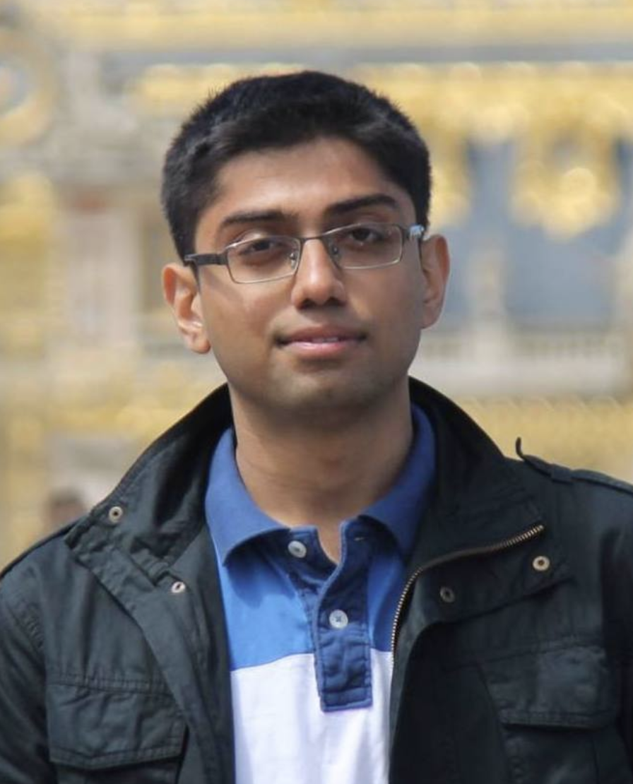
INSTRUCTOR
Amulya Yadav
PhD 2018 → University of Southern California (USC)
Personal Research
Artificial Intelligence and Machine Learning for Social Good
Raising Awareness about HIV among Homeless Youth using AI Techniques
Video - https://www.youtube.com/watch?v=eWvE7Gvsr9c
ML to Promote Farmer Incomes, Deep Learning to Teach Autistic Ki
Preventing Poachers using AI/ML based Randomized Patrol Patterns

Slide 4
Contact Me
Most Preferred Method (for questions/doubts/discussion on course content):
Piazza: piazza.com/psu/fall2019/ist40204 (Access Code: 402.4)
For any other question:
Email: amulya@psu.edu
Send a reminder email if I don’t respond within 24 hours
My Office Hours (if you want to meet in person)
By appointment – please send me an email to schedule an appointment

Slide 5
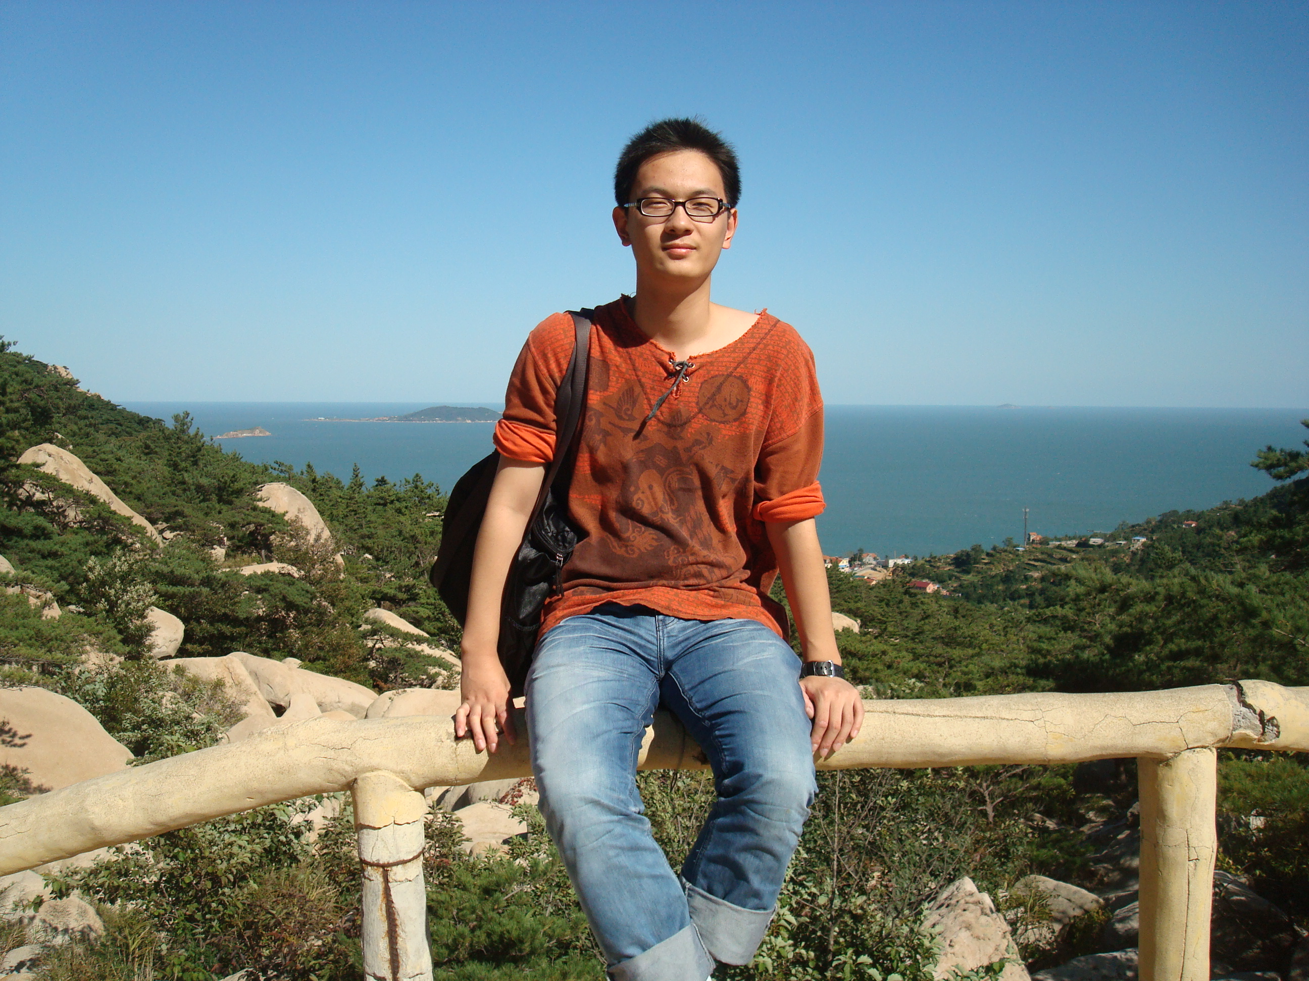
Teaching Assistant
KAIXUAN ZHANG
Ph.D. Student at IST

Slide 6
Teaching Assistant
Kaixuan Zhang (Email: kuz22@psu.edu)
TA Weekly Office Hours
2:30 PM to 4 PM, Monday and Wednesday
Location: E301 Westgate
Starting next week when Kaixuan returns!
One stop person to answer all your questions about this course!
He will be there on Piazza to answer any questions that you might have

Slide 7
CLASS Schedule
Tuesdays and Thursdays
Time: 4:35 PM to 5:50 PM
Location: Earth and Engineering Sciences 121

Slide 8
Course content
What is this course about?
Machine Learning has impacted our society in a profound way
Almost every device/computer/mobile application that you can envision uses ML in some or the other way
Recent Trend: The Rise of Deep Learning
Often called a panacea for all problems affecting society?

Slide 9
The rise of deep learning
Personal Assistants
Recommendation Systems
Text Scanning
Advertising
Face Recognition
Anomaly Detection

Slide 10
The rise of deep learning
Language Translation
Music Search
3D Modeling
Image Detection and Manipulation
Speech to Text
Route Planning

Slide 11
COURSE CONTENT
You must know about ML as an IST graduate
Quickly becoming indispensable!
Lots of money is being spent around the world to do ML research
State of the field of ML is dynamically evolving
New frontiers of research are continuously being opened
Information in ML books is quickly becoming obsolete
This course introduces the most recent trends in the field of ML

Slide 12
COURSE LEARNING GOALS
Learn about new emergent trends in ML research
Deep Learning
Fairness in Machine Learning
Transparency in Machine Learning
Adversarial Machine Learning
Deep Fakes
Ethics in Machine Learning
Goal: At the end of the course, you should be capable of holding an intelligent “meta-level” conversation about any of these topics with any person (including AI experts)

Slide 13
COURSE LEARNING GOALS
Learn about new emergent trends in ML research
Deep Learning
Fairness in Machine Learning
Transparency in Machine Learning
Adversarial Machine Learning
Deep Fakes
Ethics in Machine Learning
Goal: At the end of the course, you should be capable of holding an intelligent “meta-level” conversation about any of these topics with any person (including AI experts)
VERY LITTLE TECHNICAL CONTENT, MATH, ETC.

Slide 14
COURSE SYLLABUS
General outline of syllabus is available at course website:
https://amulyayadav.github.io/EmergingTrendsML/
But that is subject to change. Why?
ML Research evolves every day. To account for this dynamic nature, we will adaptively incorporate/remove articles from our syllabus to reflect cutting-edge developments around the world
Want to find out more about you! What do you want from this course?
Poll at https://www.surveymonkey.com/r/H282W8X

Slide 15
COUrse evaluation
No exams, no assignments!!! ☺
Reflective Statements on Articles/Papers – 30%
Class Participation – 10%
Class Note and Class Presentation Scribing – 10%
Final Project – 50%

Slide 16
Reflective Statements on Articles/Papers – 30%
There is a paper/reading list for each class.
Students are expected to finish the class readings before class
Critical reflection statements on class readings due 24 hours before each class
Critical Reflection Statement – 2-3 paragraphs should be sufficient, not more than that
Think you are reviewing a paper. The summary should similarly have three paragraphs
Your opinion on the paper/article
Any weaknesses in the claims made
Any ideas for Potential Extensions to the Paper/article

Slide 17
Class Participation – 10%
For each class, I will compile the reflective statements that you submit into a powerpoint
Use that to drive discussion around the paper/article content
Student is expected to take active part in that discussion. The instructor will encourage discussion by asking the right questions, but most of the answers are expected to be given by students.

Slide 18
Class Note and Class Presentation Scribing – 10%
Class has 45 students (I think)
15 weeks of classes
Students will be divided into 15 groups of 3, one for each week
Each student group will be responsible for preparing course notes and lecture presentations based on the discussion that we have during the week
Each group will only be responsible to prepare notes and slides for a single week during the class

Slide 19
Final Project – 50%
Use the same groups of 3 (more preferable but won’t enforce this)
Groups of 3 students, project proposal due by mid semester (20% of total grade), final project project report at the end of class (30% of total grade). Instructor will provide detailed feedback on the project proposal and that should be addressed in the final project report.
Main points of evaluation in the 30% grade will include: (i) Relevance to class topic; (ii) Illustration of use of concepts learned in class or from research papers in related areas; (iii) Survey of related research in the field to indicate awareness of this work; (iv) Novelty of ideas. There is considerable flexibility in the kind of project completed.

Slide 20
Grading policy
Late Policy
Critical Reflection Statement:
No Late Days Allowed
10% Penalty for that Statement Per Each Late Day
Note and Presentation Scribing
3 Late Days Allowed
Project Proposal and Project Report:
No Late Days Allowed
Please Contact Instructor One Week in Advance if you cannot present your allotted paper for some reason

Slide 21
Academic Integrity
Your submissions should be your own work!
Discussing papers with your peers is allowed, even encouraged!
However, you should write your own paper summaries.
Be careful not to plagiarize anyone else’s idea in your project proposal and final project report.

Slide 22
Questions?
ACTION ITEMS
Give survey at https://www.surveymonkey.com/r/H282W8X
Register at Piazza: piazza.com/psu/fall2019/ist40204 (Access Code: 402.4)
Form teams of 3 for your scribing duties by end of this week (please post your groups on Piazza by Sunday)
Keep discussion of group formation in the “other” folder on Piazza

